Slide 1
Fall 2023 CWEL New Student Orientation

Slide 2
Agenda/Topics to Be Covered
Welcome/Introduction of Staff-H. Cahalane
Purpose of CWEL-H. Cahalane
Reimbursements-J. DiPasqua
County Connections-L. Borish
FAQ’s and Student Wisdom-CWEL Graduates
Closing/Contact Information
Student Responsibilities-A. Johnson
Systems/Important Documents-Y. Hamm

Slide 3
Who’s Who
Dr. Alicia Johnson- Academic Coordinator
Course/School related concerns
Professor Laura Borish- County Agency Coordinator
Work-related concerns
Ms. Yvonne Hamm- Senior Program Administrator
Mr. Joseph DiPasqua-Program Administrator
Reimbursement related questions
Forms and Systems
Dr. Helen Cahalane- Principal Investigator
Mr. Michael Schrecengost-Chief Fiscal Officer
Dr. Marlo Perry-Associate Research Professor/Director

Slide 4
PURPOSE of CWEL
The CWEL program is designed to strengthen public child welfare services in Pennsylvania by providing educational opportunities at the graduate level for public child welfare personnel.

Slide 6
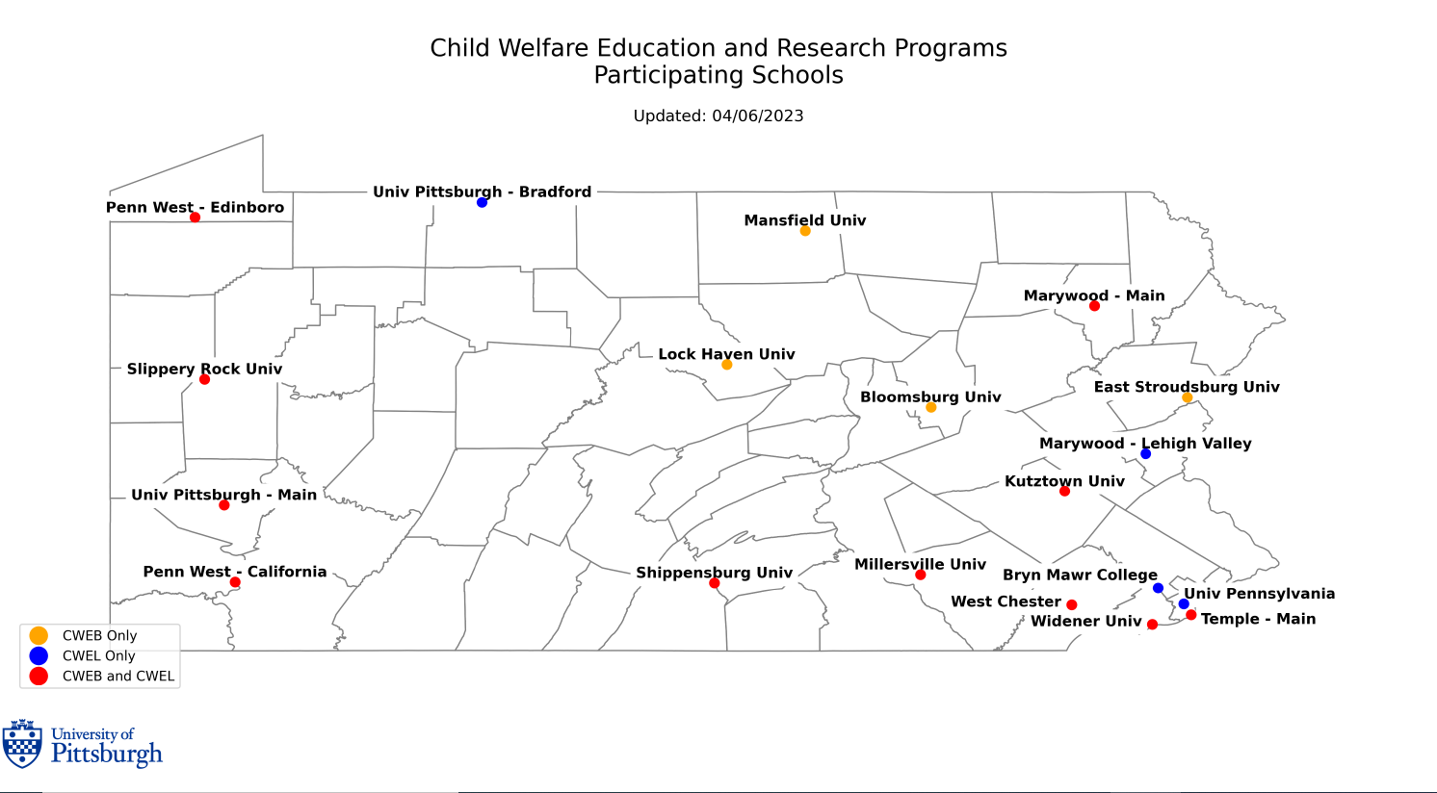
Notes:
CWEB Map 2023

Slide 7
Student REsponsibilities
Course of Study *
Certificate Programs/Dual Degrees/Foreign Travel
Field Placements
Enter Courses into CWERP
Rectify Grad Date and other Discrepancies/Respond to Emails Quickly
In-State Tuition and Payments
Refunds
Student Account Holds
Student Information Updates in Database (incl. No Courses)
*PennWest

Slide 8
Systems/important documents
Required forms (FERPA, W9, Peer Communication Form, Contract)
Student Information Form (SIF)
www.cwerp.pitt.edu
Please contact me with issues re: entering courses, submitting documents, issues accessing CWERP, etc.

Slide 9
reimbursement
Books & Supplies
mileage
School deposits and graduation fees
Navigating through CWERP

Slide 10
Summer Funding
Different Procedure
Must request funding
Even for courses required to be taken in summer
Observe deadlines
Up to one course for FT/up to two courses for PT

Slide 11
County connections
Agency Coordinator=Liaison for all things county related
CWEL participation begins on the first day of classes and ends at graduation
Counties determine full-time or part-time CWEL participation
Educational leave along with salary/benefits reimbursement for new full-time CWEL students begins on the first day of classes
Return to work letters are sent in November and March
Contact Agency Coordinator with any work-related concerns
Commitment is calculated after graduation

Slide 12
FAQs
1. Where can I go if I have additional questions about the CWEL program?
2. Where can I go if I have additional questions about reimbursements?
3. What happens if I need to take a leave of absence from school/work?
4. Can I participate in a paid fellowship/internship?
5. Can we increase our options for CWEL-approved electives?
6. Does CWEL pay for accident or health insurance required by the university?
7. Can CWEL pay for tuition or costs related to prerequisite courses?
8. What additional questions do you have?

Slide 13
Yvonne Hamm, Senior Program Administrator
ymh4@pitt.edu
Office: (412) 624-7273
Joseph DiPasqua Program Administrator jfd28@pitt.edu Office: (412) 624-6310 Laura Borish, MSW/LSW CWEB/CWEL Agency Coordinator and Clinical Assistant Professor lbb14@pitt.edu Office: (412) 648-2371 Cell: (412) 334-9122 Alicia D. Johnson, Ph.D. CWEL Academic Coordinator, Clinical Assistant Professor adj56@pitt.edu Office: (412) 624-6387 Cell: (412) 512-0815

Slide 14
Student wisdom
How do you explain your job to someone who doesn’t know anything about child welfare?
How do you maintain your professionalism when your work/profession is challenged by others?
What do you wish you knew at the start of this program?
What creative ways have you juggled school/work/life to create balance?
What hacks have you found to make navigating requirements easier?

